Slide 1

A novel Bayesian hierarchical
model for road safety hotspot prediction
Lee Fawcett , Neil Thorpe , Joseph Matthews , Karsten Kremer
Data
The dataset includes accident counts from 734 sites in Halle for the years 2004 to 2012. These are referred to as the observations. For each site, numbered from 1 to 734, various covariates are recorded, such as traffic volume, speed limit, and whether the site is in an urban area.

Slide 2
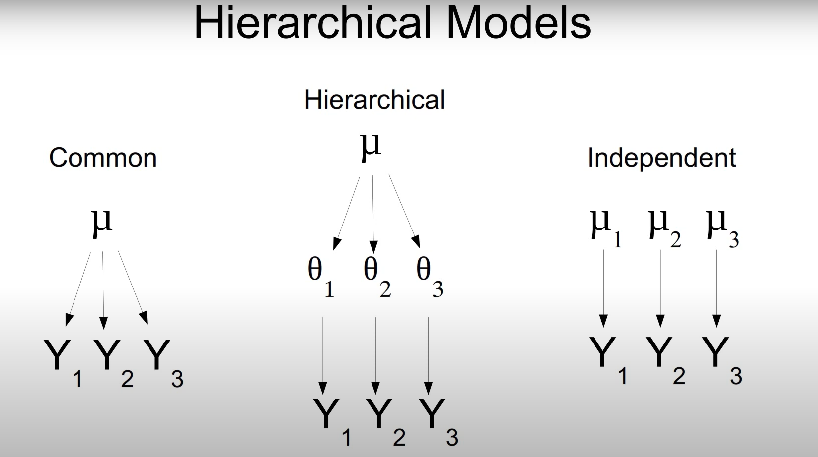
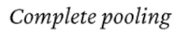
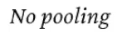

Slide 3
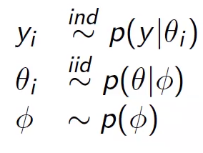
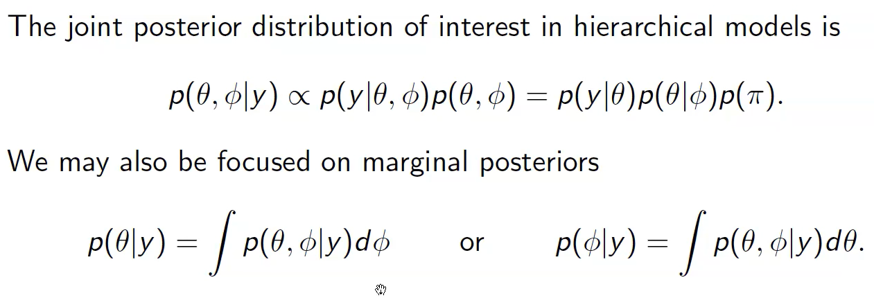

Simple Hierarchical Model
We have used the same approach in our model with more number of parameters but the underlying idea is same

Slide 4
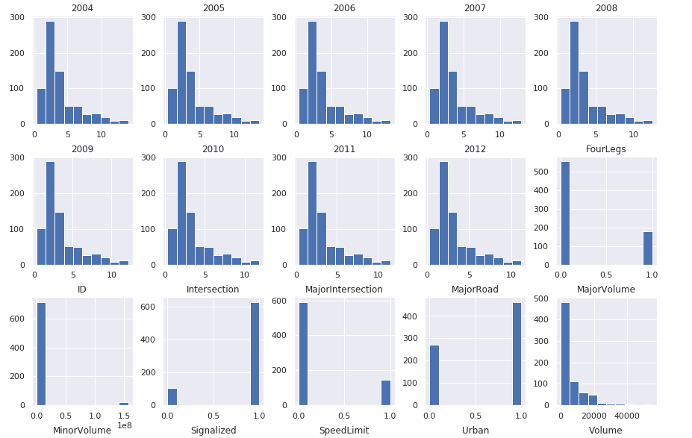
Our variables follow a distribution which we want to learn via our modeling
Distributions of all variables in the data
the distributions of yearly accident totals from 2004 to 2011.
count
all available covariates and their distributions
value
3

Slide 5
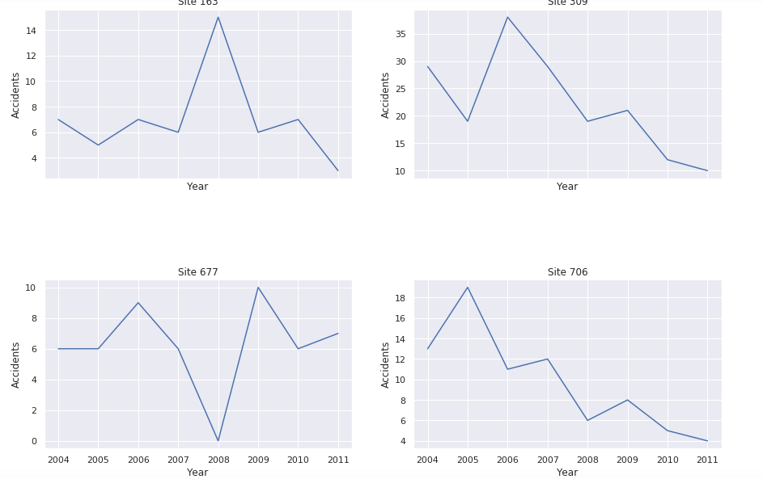
Accidents at sites are influenced by random effects and trends, both of which are considered in our modeling approach.
Time series plots of accidents at selected sites
Site 163 Site 309
Sites 163 and 677 indicate potential RTM effects
A recent spike in accidents at a particular site, such as in the previous year, could either indicate a significant safety issue or simply be a random fluctuation. If the increase is random, the number of accidents is likely to decrease in the following year regardless of whether safety measures are implemented, due to regression to the mean. This RTM effect may have been observed after 2008, with accident numbers naturally returning to an average level by 2009
Sites 309 and 706 suggest evidence of temporal trend
The issue of trends arises when a reduction in accidents following the implementation of a safety measure could be attributed either to the measure itself or to broader site-specific or global trends, such as a general decrease in driving speed. These trends can vary locally, as indicated by the downward trends observed only at sites 309 and 706.
Accidents
Accidents
Year
Year
Site 677
Site 706
Accidents
Accidents
Year
Year
4

Slide 6
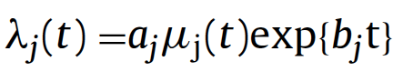
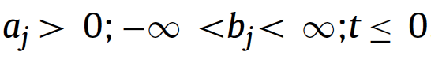



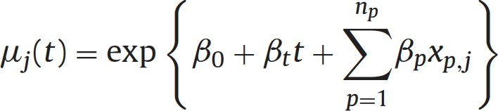


We follow the same steps as Fawcett et al. in their paper
Bayesian Hierarchical Model
Rank sites according to hotspot potential
Posterior Sampling
aj which accounts for random effects (RTM) and bj which tackles the confounding effects of local trend
Accident Prediction Model
Evaluation

Slide 7
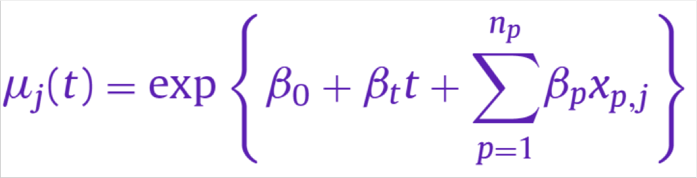
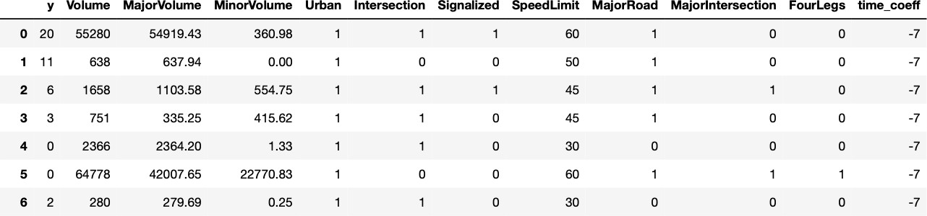
To implement the Accident Prediction Model, we have to do data rearrangement and calculate the coefficients first (1/2)
Modelling the APM according to Fawcett et al. 2017
7

Slide 8
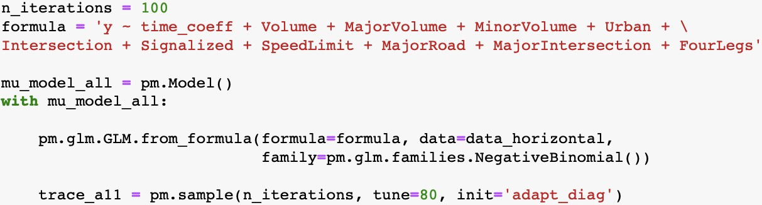
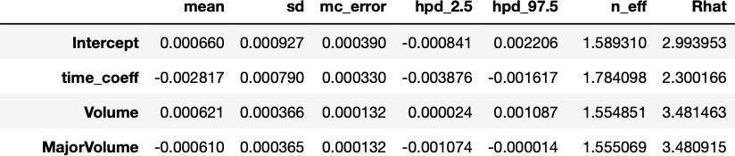
To implement the Accident Prediction Model, we have to do data rearrangement and calculate the coefficients first (2/2)
Modelling the APM according to Fawcett et al. 2017
7

Slide 9

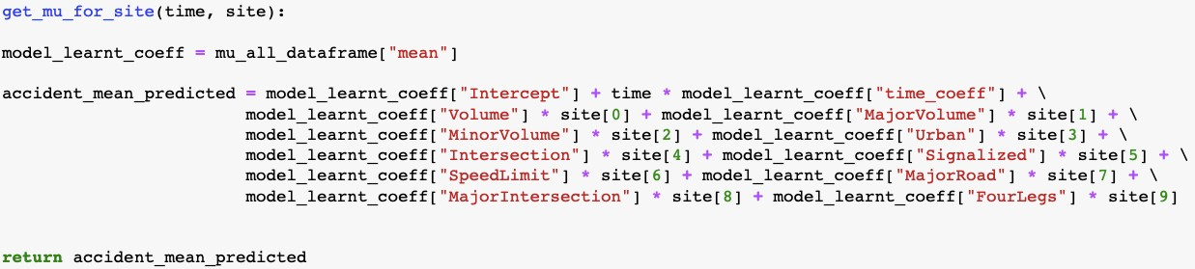
Then, we calculate the mean accident rate for each site and each time ...
Modelling the APM according to Fawcett et al. 2017
prefer recent years to stronger inform decisions––a lot could have happened in the meantime
8

Slide 10
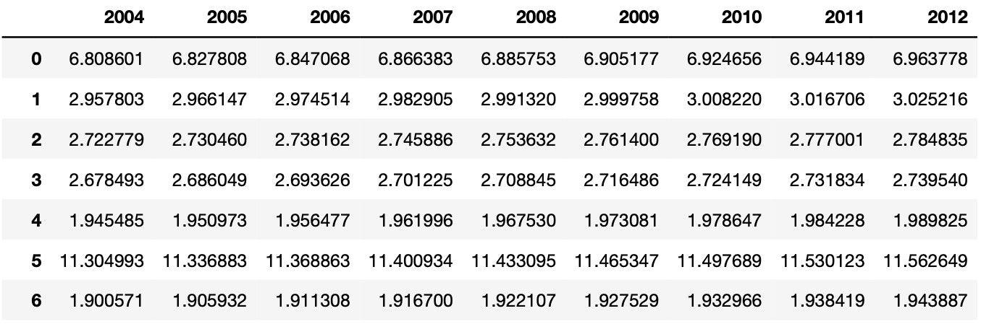
... and encounter two problems
Modelling the APM according to Fawcett et al. 2017
We do not account for RTM and trend yet!
8

Slide 11
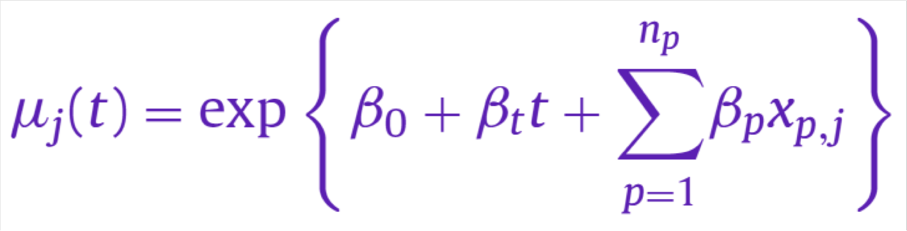
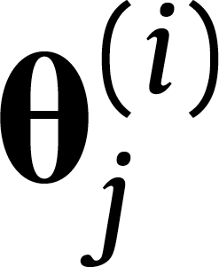
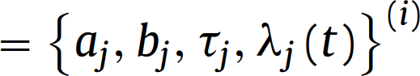
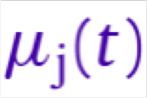
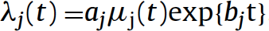
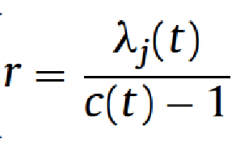
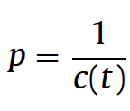
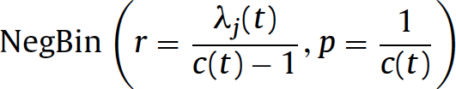
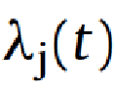
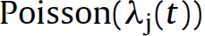
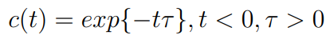
We account for RTM and trend by building a Bayesian Hierarchical Model on top of the APM
Model according for RTM and trend according to Fawcett et al. 2017
Negative Binomial distribution allows for different mean and variance, whereas for the Poisson distribution mean and variance are assumed to be the same . discrete data and the events occurring are independent of the time since the last event.
The reason behind including c(t) is to give more weight to recent accidents
9

Slide 12
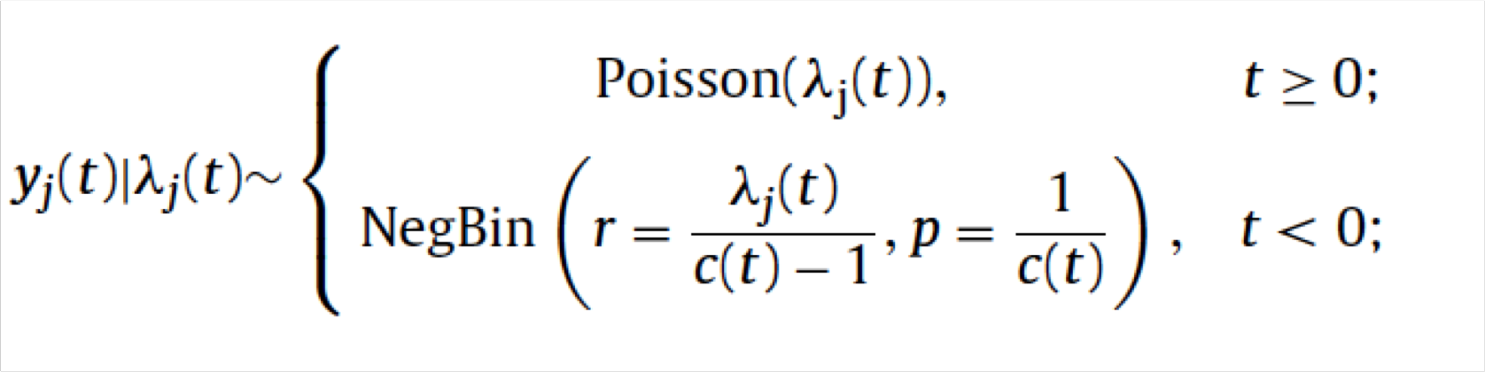
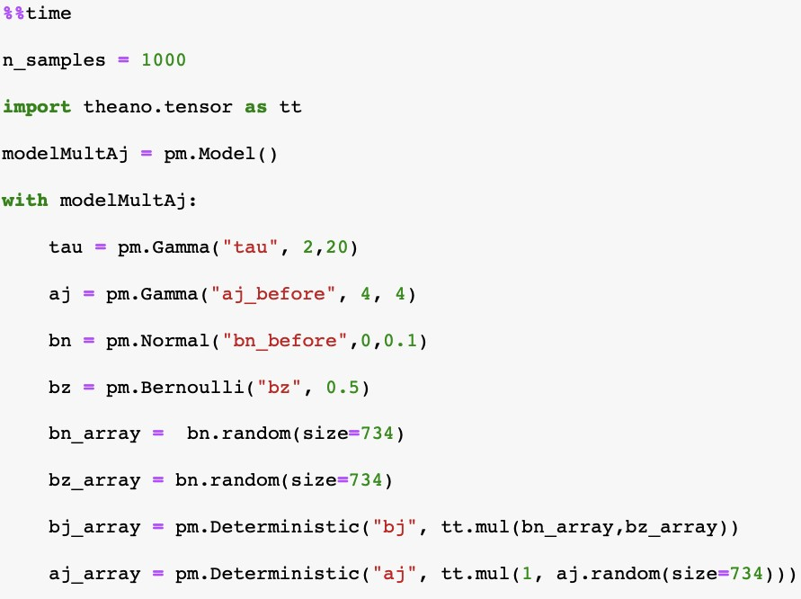
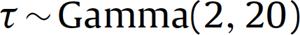
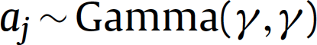
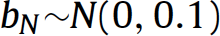
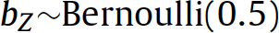
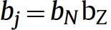
For the modeling, we first have to initialize the priors according to what is specified in the paper
Prior initialization
aj helps us to capture causes we have not captured in our observations
In bj , bz acts as the zero-inflation component that penalizes the global trend detected by the global APM.

Slide 13
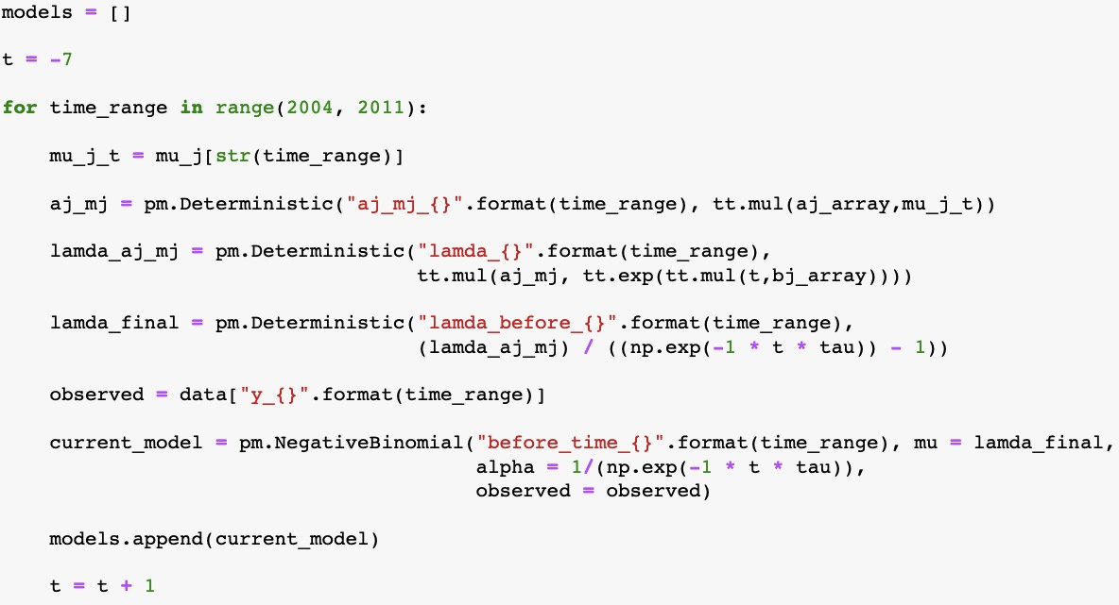
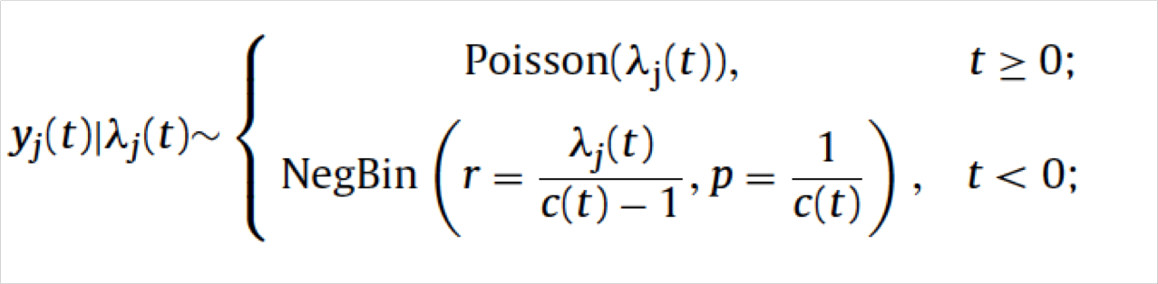
The pymc3 library allows us to smoothly apply a Negative Binomial Distribution to the “before” time period

Slide 14
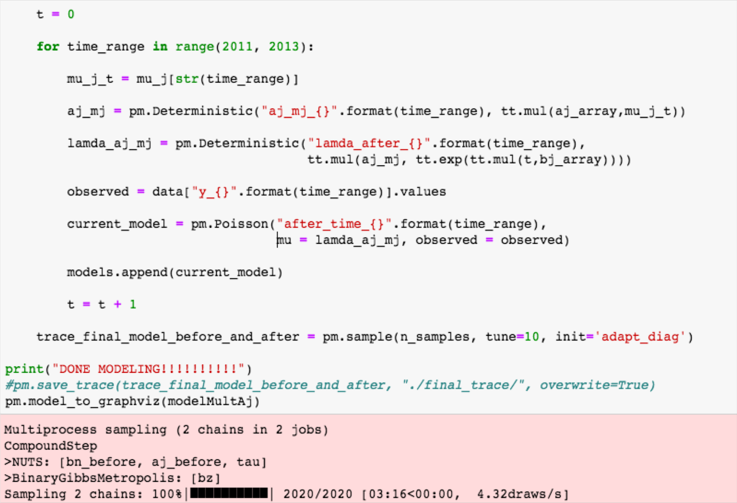

For the “after” time period data, we have applied a Poisson distribution

Slide 15
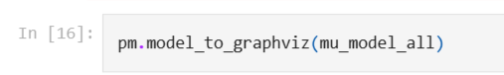
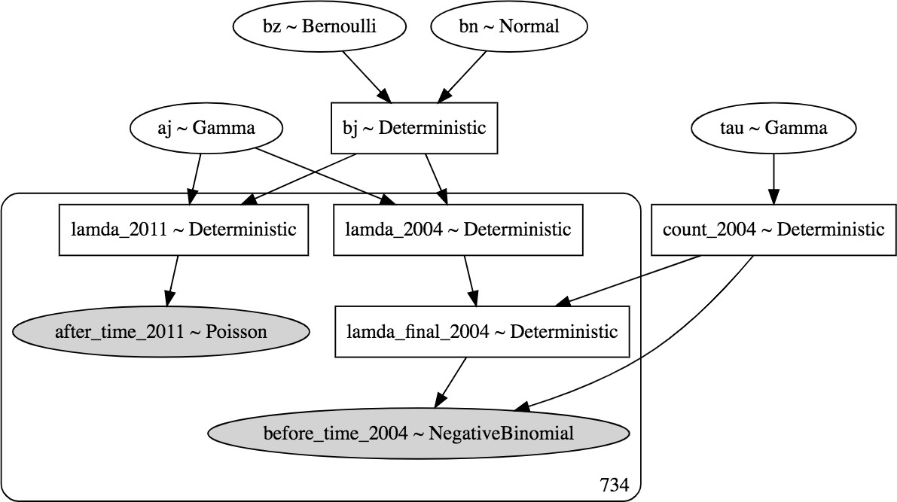
Plate notation of the model makes it easy to understand our model
Representation of our model based on Fawcett et al. 2017
MCMC sampling technique to simulate approximate draws from the marginal posterior
Trained the model with 1,000 iterations due to time and space constraints in paper it was 10,000
model was trained with Python using the pymc3 library

Slide 16
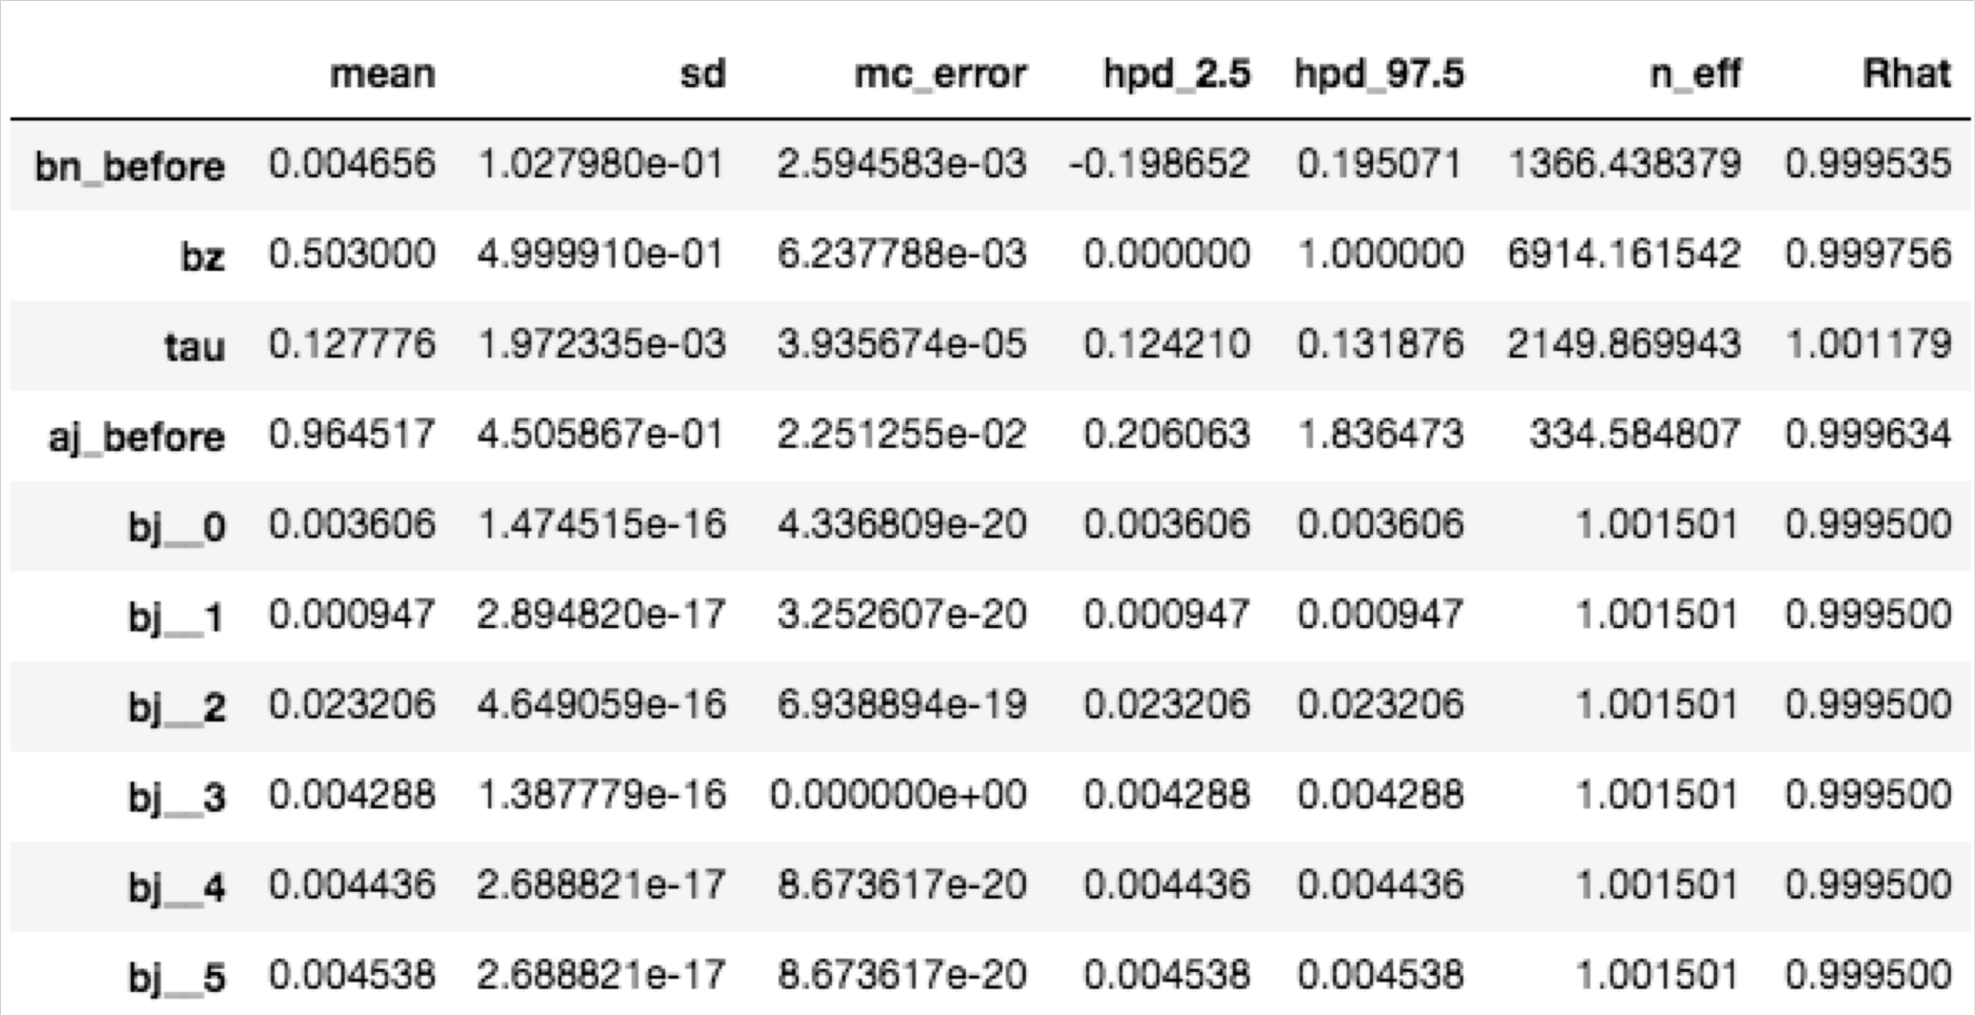
As the posterior summary indicates, we have learnt RTM and local trend for each site
Posterior summary of our model based on Fawcett et al. 2017

Slide 17
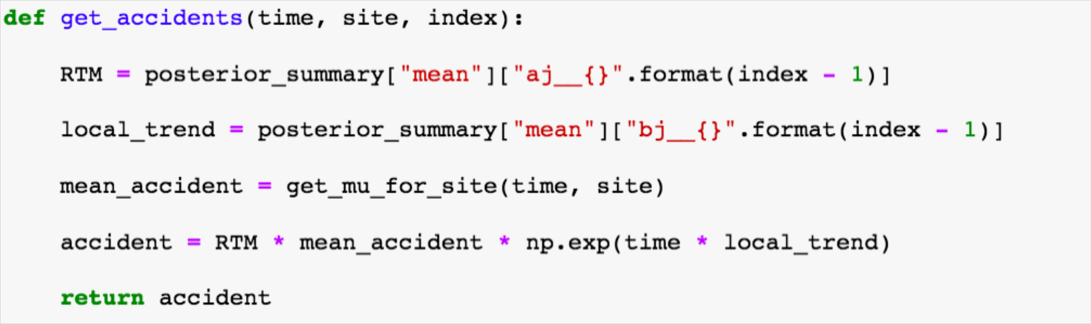
For accident predictions we need to use learnt RTM, local trend and global trend along with mean accidents
RTM
Local
Trend
Global
Trend

Slide 18
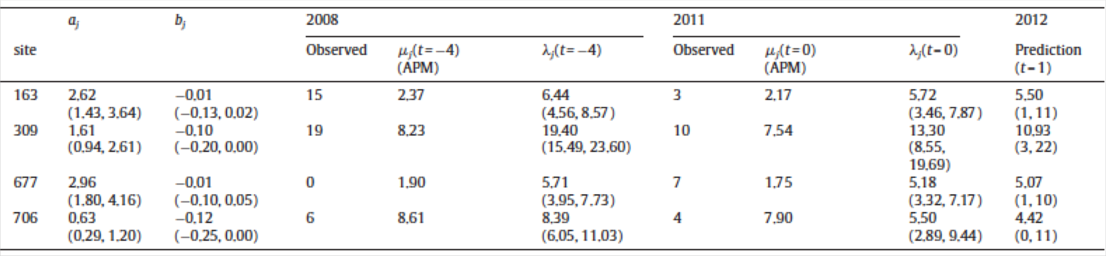
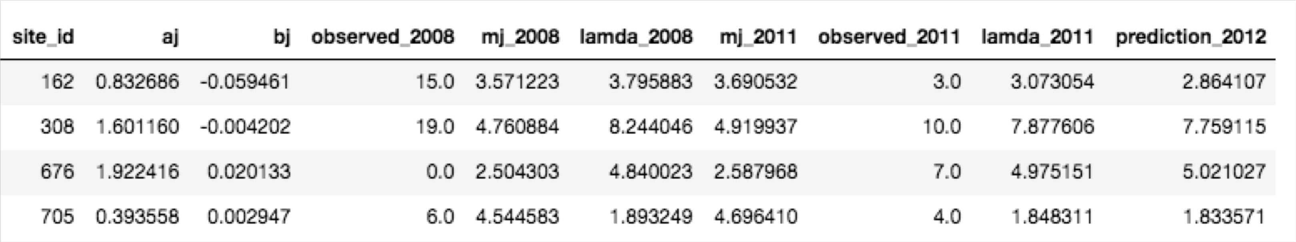
According to posterior results, the model we built is close to Fawcett et al. 2017
Comparison of posterior results

Slide 19
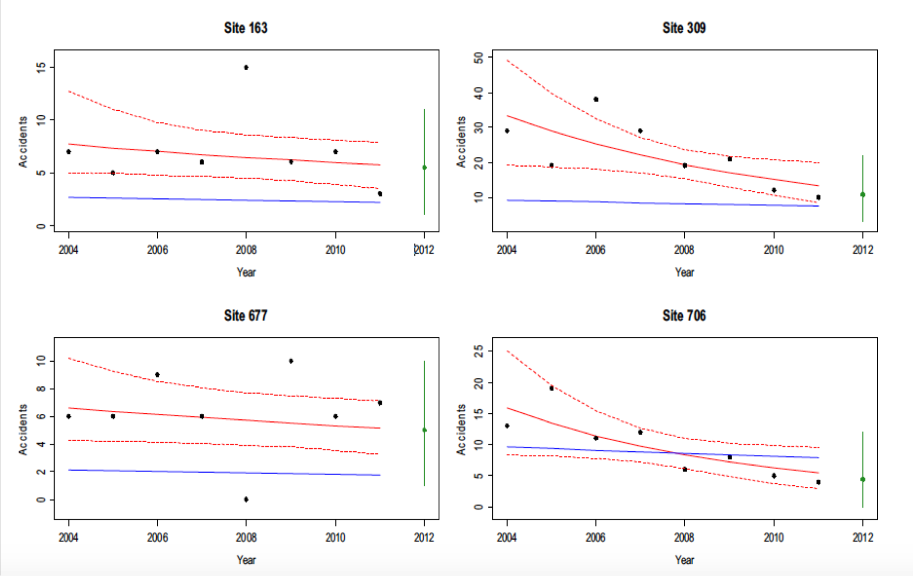
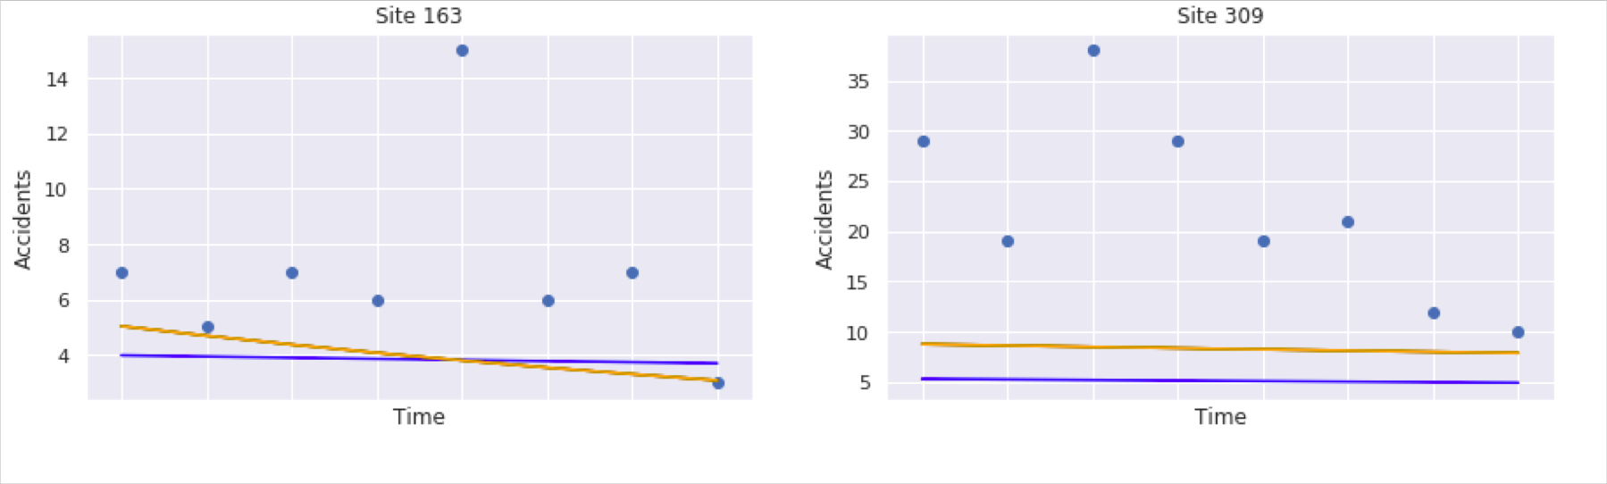
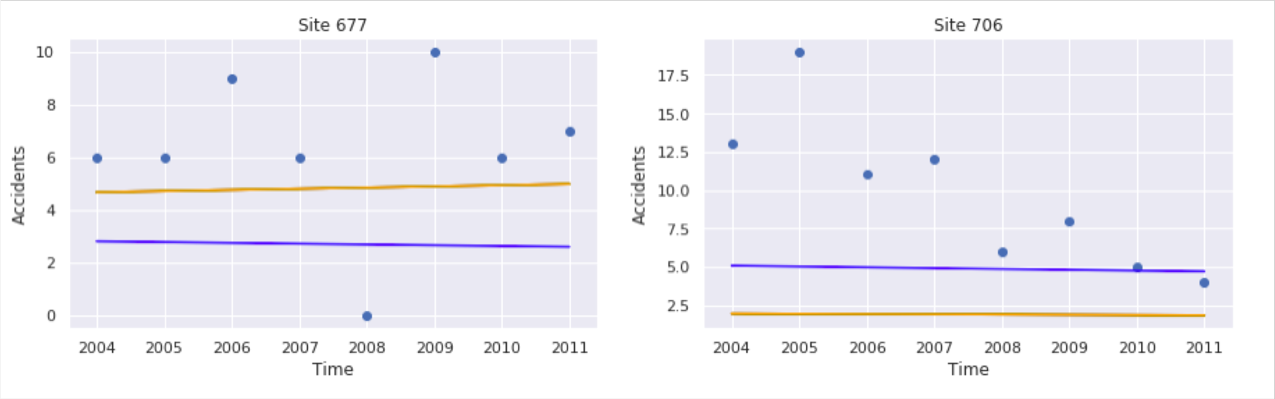
Our model has learned the trend element correctly and is fitting quite well
Comparison of (predicted) accidents at sites over years
Site 163
Site 309
Site 163
Site 309
Accidents
Accidents
Accidents
Accidents
Years
Years
Years
Years
Site 677
Site 706
Site 677
Site 706
Accidents
Accidents
Accidents
Accidents
Years
Years
Years
Years
the blue line indicates the model fitting of the mean accident rates and the red line indicates the model fitting of the Global APM

Slide 20
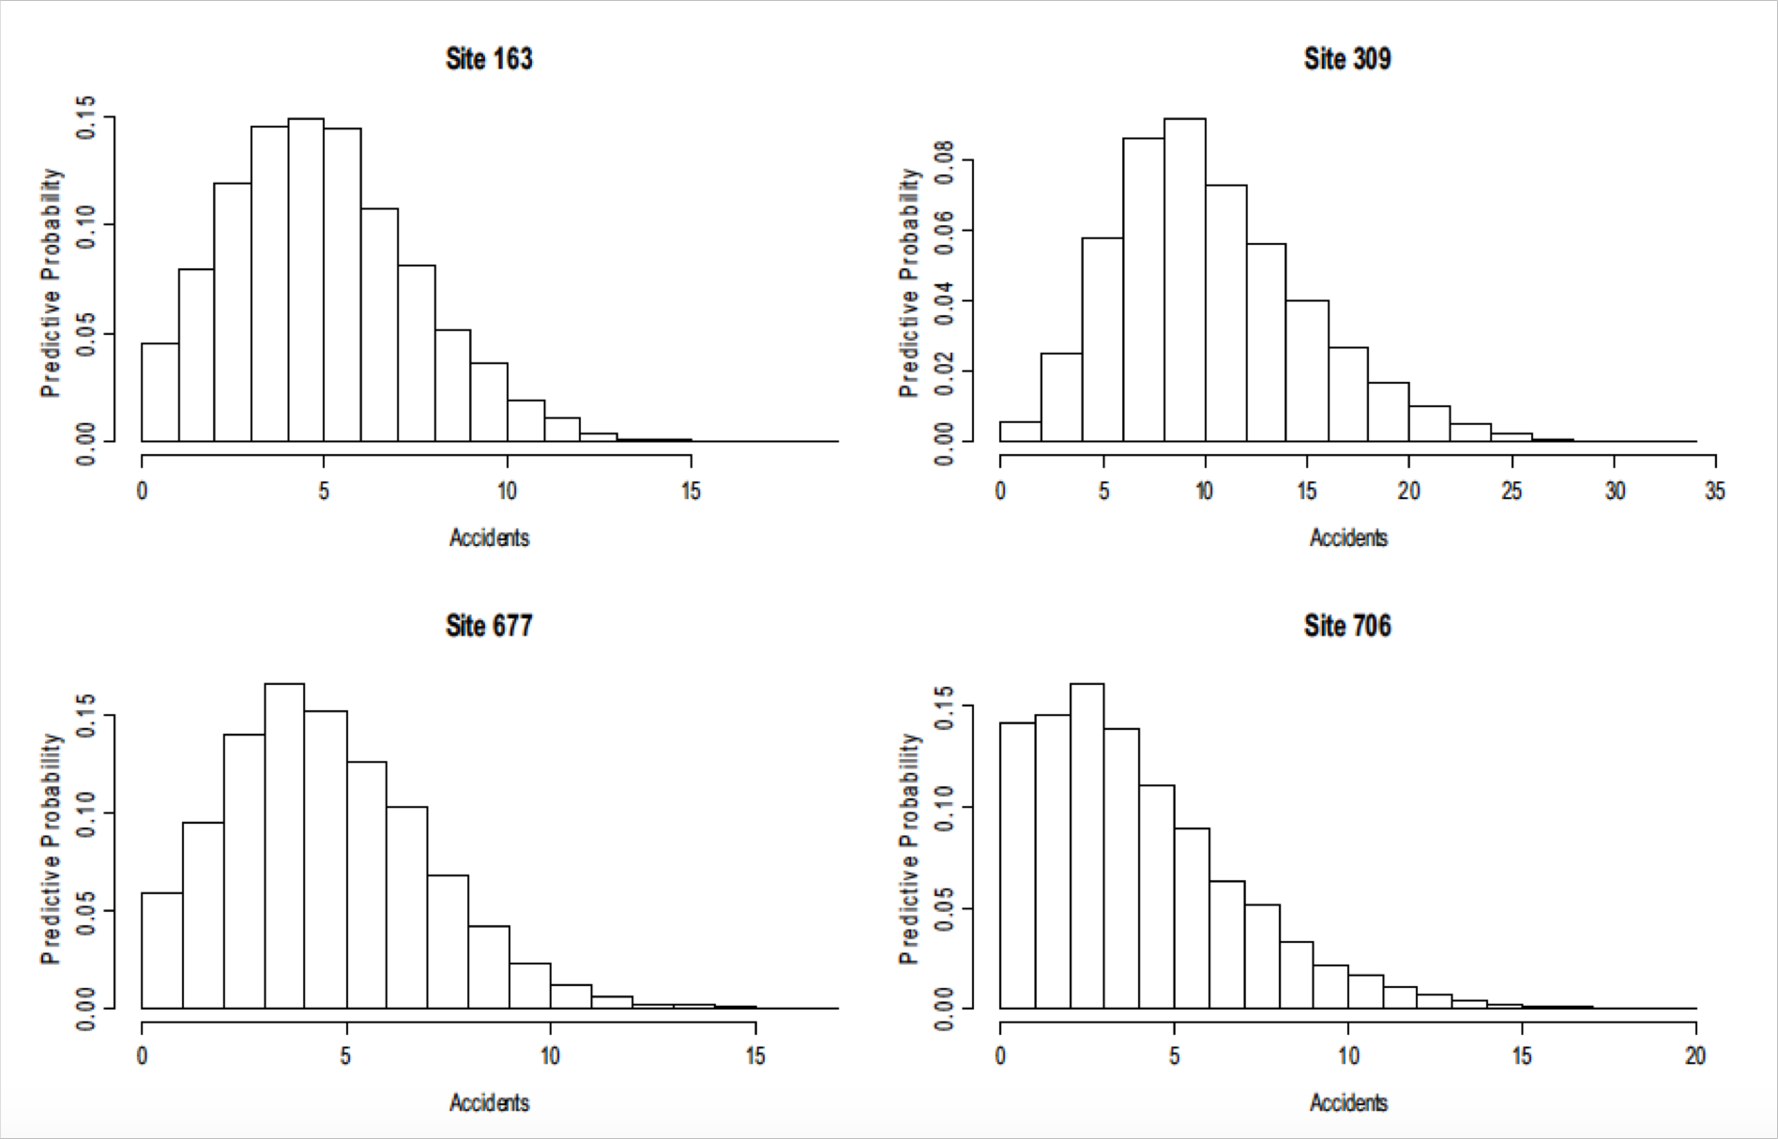
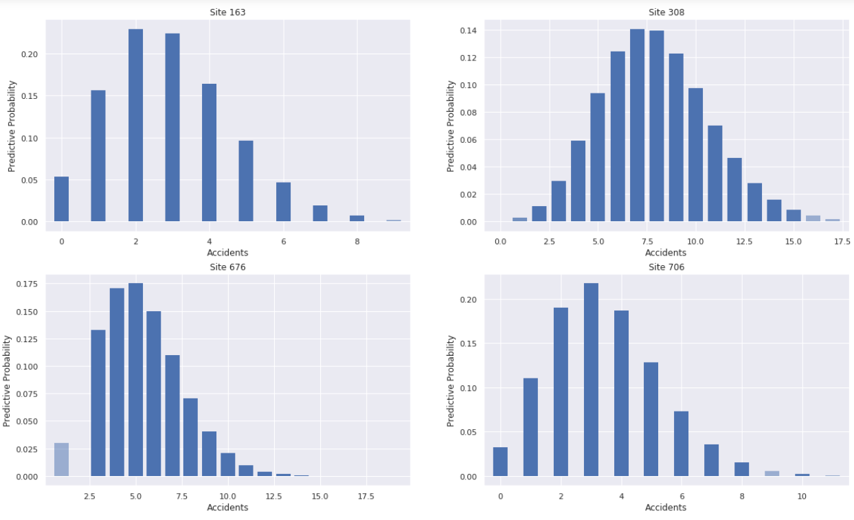
The model we built was able to generate similar posterior samples like in Fawcett et al. 2017
Comparison of posterior samples
Site 163
Site 309
Site 163
Site 309
Predictive Probability
Predictive Probability
Predictive Probability
Predictive Probability
Accidents
Accidents
Accidents
Accidents
Site 677
Site 706
Site 677
Site 706
Predictive Probability
Predictive Probability
Predictive Probability
Predictive Probability
Accidents
Accidents
Accidents
Accidents

Slide 21
Thank you!

